Slide 1

TargetWise Analytics: Customer Segmentation for Kenyan Cooperatives
A Machine Learning Solution
Presented by: Joy Lutenyo, Allen Otieno, Kemp Kuria, Samson Mutua
Course: ACS 442 NEURAL NETWORKS GROUP WORK

Slide 2
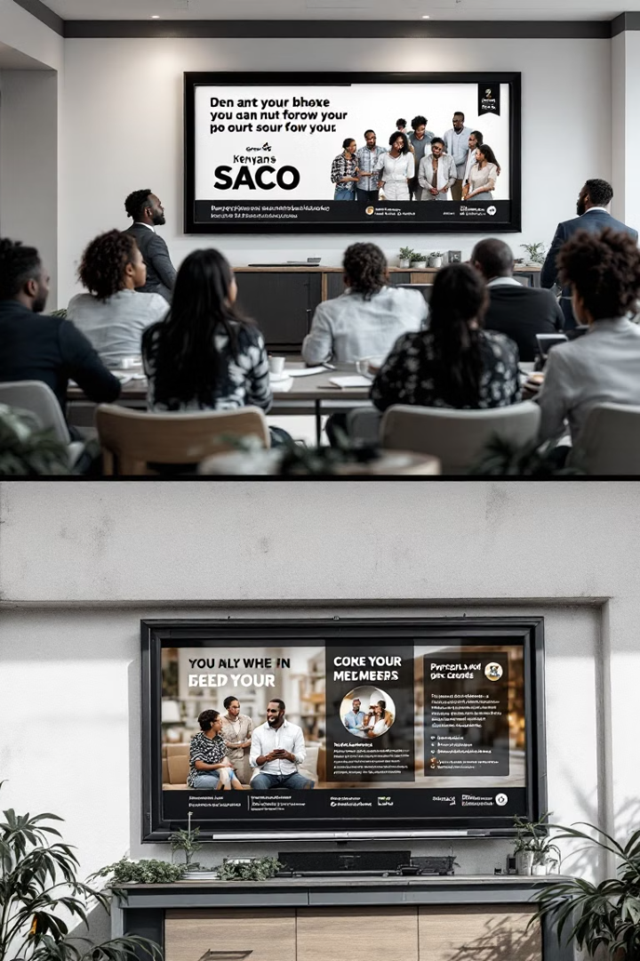




Introduction and Problem Statement
Kenyan cooperatives serve over 14 million members
Saccos and agricultural coops support rural farmers, urban professionals, and small businesses.
Generic marketing fails diverse customer bases
One-size-fits-all campaigns lead to low engagement and missed opportunities.
Goal: Segment customers for targeted marketing
Grouping customers helps tailor products and campaigns effectively.
Solution: KMeans and Random Forest in Colab
KMeans groups customers; Random Forest predicts segments.

Slide 3
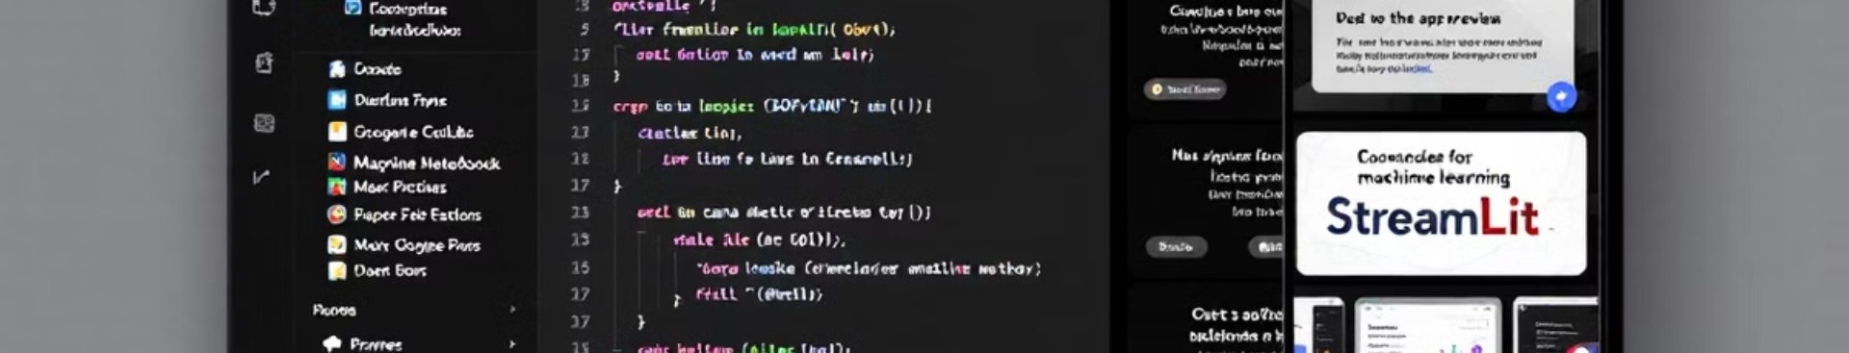




Project Overview: TargetWise Analytics
Part 1: Pipeline App
Part 2: Prediction App
Features
Vision 2030
Processes data, groups customers, and trains a model.
Data upload, clustering, prediction, and marketing insights.
Aligns with Kenya's plan for tech-driven economic growth.
Allows input of customer details to predict segments.

Slide 4
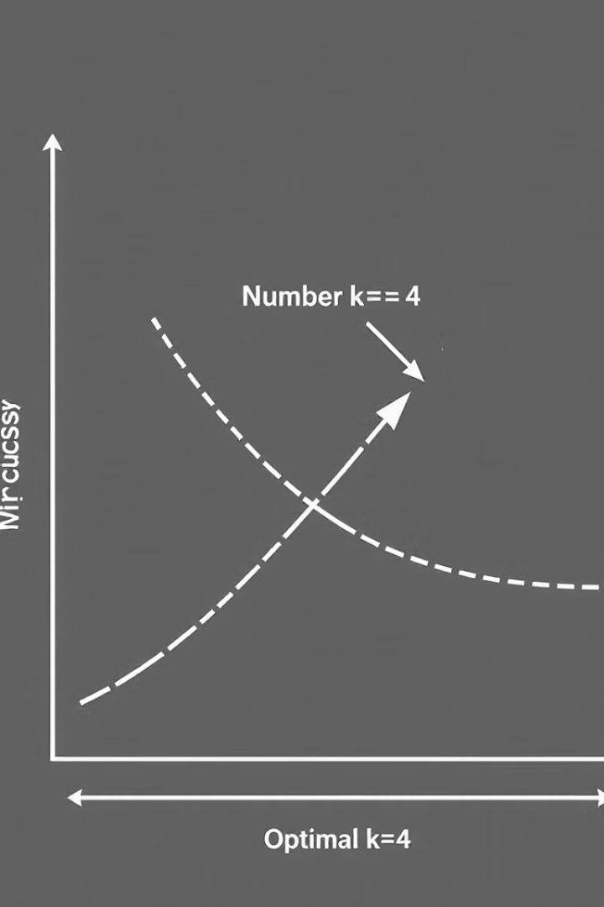




Methodology: Full Pipeline App
Data Preprocessing
Upload dataset (1319 records), drop missing values, standardize features.
Clustering
KMeans with 4 clusters (Elbow Method), visualize with PCA scatter plots.
Classification
Train Random Forest on cluster labels, save model for real-time use.
Insights
Provide marketing recommendations per cluster.

Slide 5
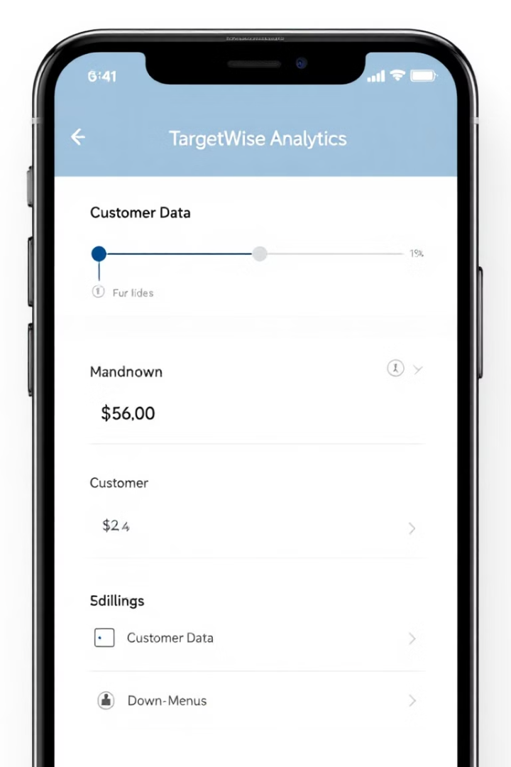
Methodology: Real-Time Prediction App
Input Form
Enter customer details (age, income) using sliders and dropdowns.
Prediction
Load saved Random Forest model to predict segment in real-time.
Output
Display predicted segment and provide marketing insights.
Deployment
Hosted in Colab using Streamlit for free access.

Slide 6








Implementation in Colab
Two Scripts
Models
Full pipeline app and real-time prediction app.
KMeans for clustering, Random Forest for classification.
Dataset
Tools
Kaggle Credit Card Dataset (1319 records).
Python, scikit-learn, Streamlit.

Slide 7
App Features and Styling
Key Features
Styling Elements
Data upload and preprocessing
Fixed title: "TargetWise Analytics"
Visualizations (Elbow Method, PCA plots)
Sidebar: #d3d8e8, main: #f0f2f6
Real-time segment prediction
Black font for visibility

Slide 8
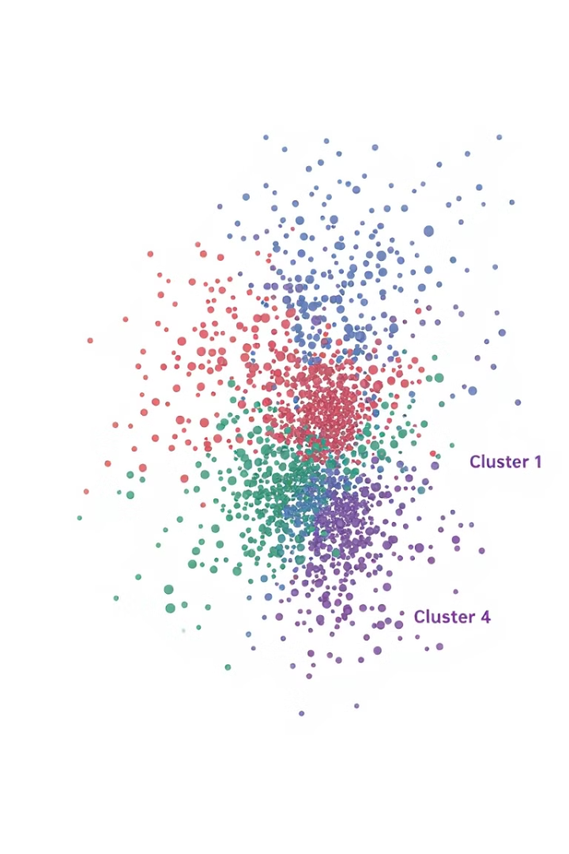
Results and Insights
4
Customer Segments
Distinct clusters identified by KMeans
97.35%
Model Accuracy
Random Forest classification performance
1
Loyal Cluster
Target with loyalty programs
3
Precision Cluster
Ideal for targeted campaigns

Slide 9



Challenges and Solutions in AI Model Training
Dataset Bias
Overrepresents urban customers; future work to include diverse data like M-Pesa transactions.
Imbalanced Clusters
Used F1-score for evaluation; suggest SMOTE for future balancing.
Ethical Concerns
Used anonymized data; ensured inclusive marketing strategies.

Slide 10










Conclusion and Future Work
Expand to other sectors
Retail, e-commerce, and more
Apply SMOTE
Balance dataset for better performance
Use M-Pesa data
Better represent rural customers
97.35% accuracy achieved
Reliable predictions for cooperatives
TargetWise Analytics built
Effective customer segmentation
Thank you! Questions?

